Slide 1
The Warriors
Project: Analyzing forest fires
Members:
Rafael Brennand
Travis Molnoskey
Brenda Mitchell
Trevor Haney

Slide 2
Agenda
Introduction/Charter Objectives
Data Gathering: Trevor
Data Formulating:
Data Visualization: Rafael
Results:

Slide 3
Data Gathering: The search for less data
Source: Kaggle
Two sources, one source had almost a gigabyte of data but stored in SQLlite format
Source: National Oceanic and Atmospheric Administration (NOAA)
Restricted timeframe from 2005 – 2015
Data parameters: Comparing number of fires and acres burned with temperature max, wind speed, latitude, precipitation, season, and cause
Notes:
Talk about the massive amount of data we found so we had to restrict the data we used
NOAA ties in networks of weather information: https://www.ncdc.noaa.gov/cdo-web/results
NOAA API uses a token in place of an API key

Slide 4
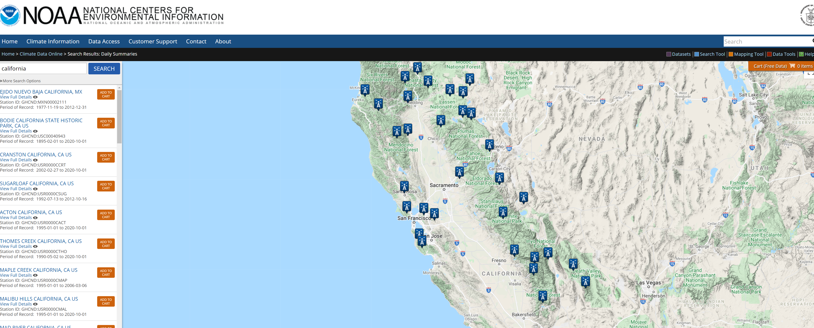
Data Gathering: The search for less data

Slide 5
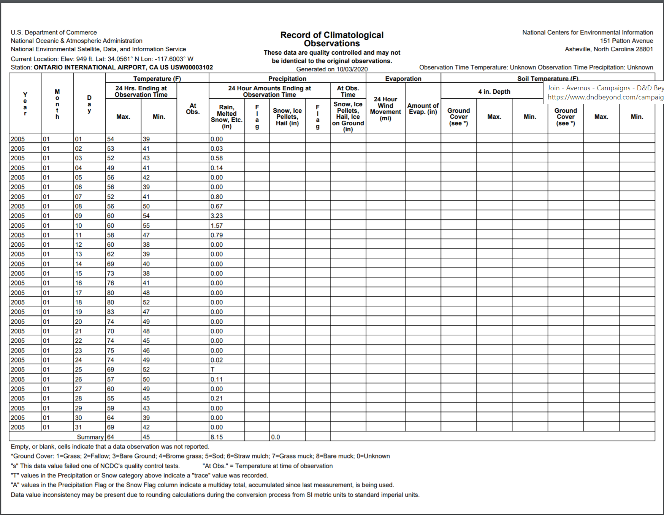
Data Gathering: The search for less data

Slide 6
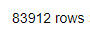
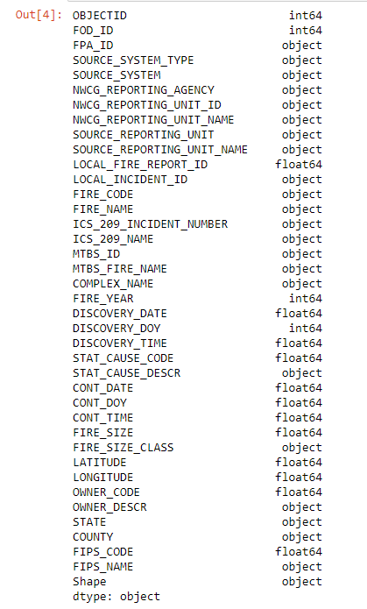
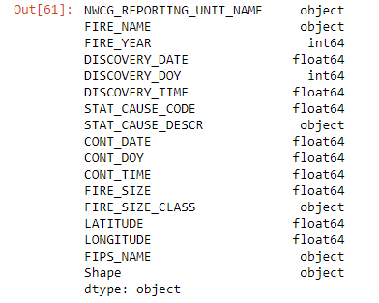

Data Formulating: Cleaning and subsetting data

Slide 7
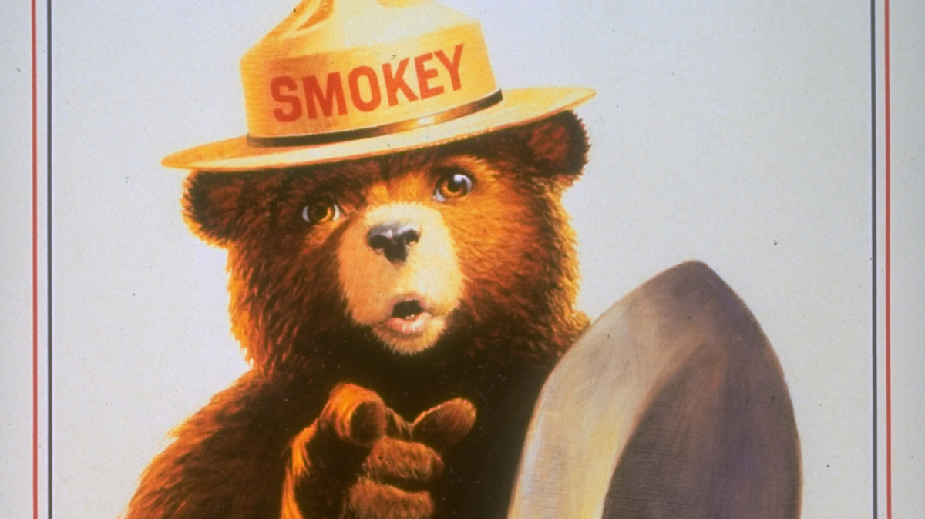
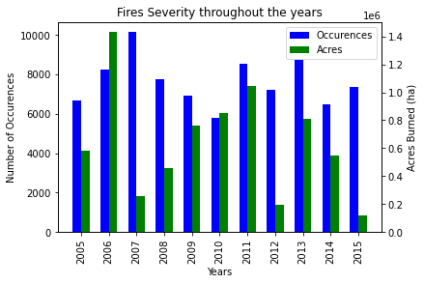
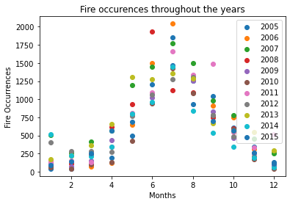
Data Visualization: Fires within our time period

Slide 8
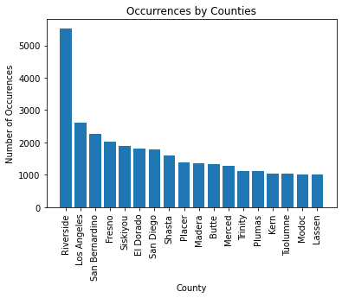
Data Visualization: Occurrences by counties

Slide 9
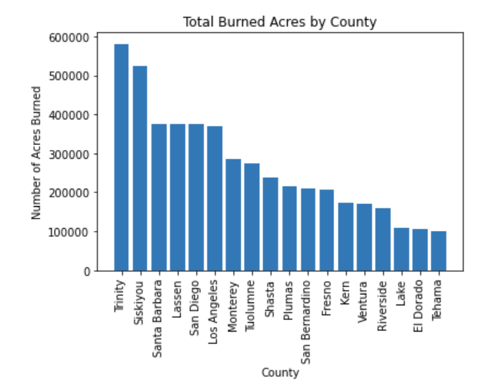
Data Visualization: Severity by counties

Slide 10
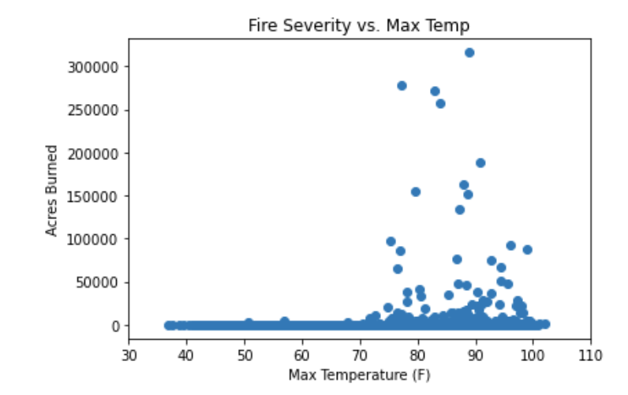
Data Visualization: Severity by Temperature

Slide 11
Questions??

